Slide 1
Bank management system
Fundamental of Programming in C++
Date: 10/09/2023
BY SOK LIMKHY

Slide 2
Bank management system
The Bank Management System automates banking operations, managing accounts, transactions, and providing security and reporting features.

Slide 3
Bank management system
Here are the key reasons why someone would want to use the Bank Management System
1. Operational Efficiency: Automation of various banking processes saves time and good environments and good looking.
2. User-Friendly Interface: Intuitive interface makes it easy for bank staff to navigate and use the system.
3. Comprehensive Features: Efficient management of customer accounts, transactions
And stuff.

Slide 4
Bank management system
Project Architecture:
-Standalone- CLI desktop application
Project strategy:
-Agile methodology [GIT FLOW]
Project Tools and tech stacks:
-About coding language: C++
-About IDE: Visual Studio Code
-More efficient way to develop: GIT/GITHUB
-For debugging: CHATGPT / Stackoverflow [look up]

Slide 5
Logical Design or Database Design
This project is having 4 main files:
1. Homepage [ Interface ]
2. Functions.cpp [ Store functions ]
3. project.dat [ Store user information ]
4. transaction.dat [ Store transactions ]

Slide 6
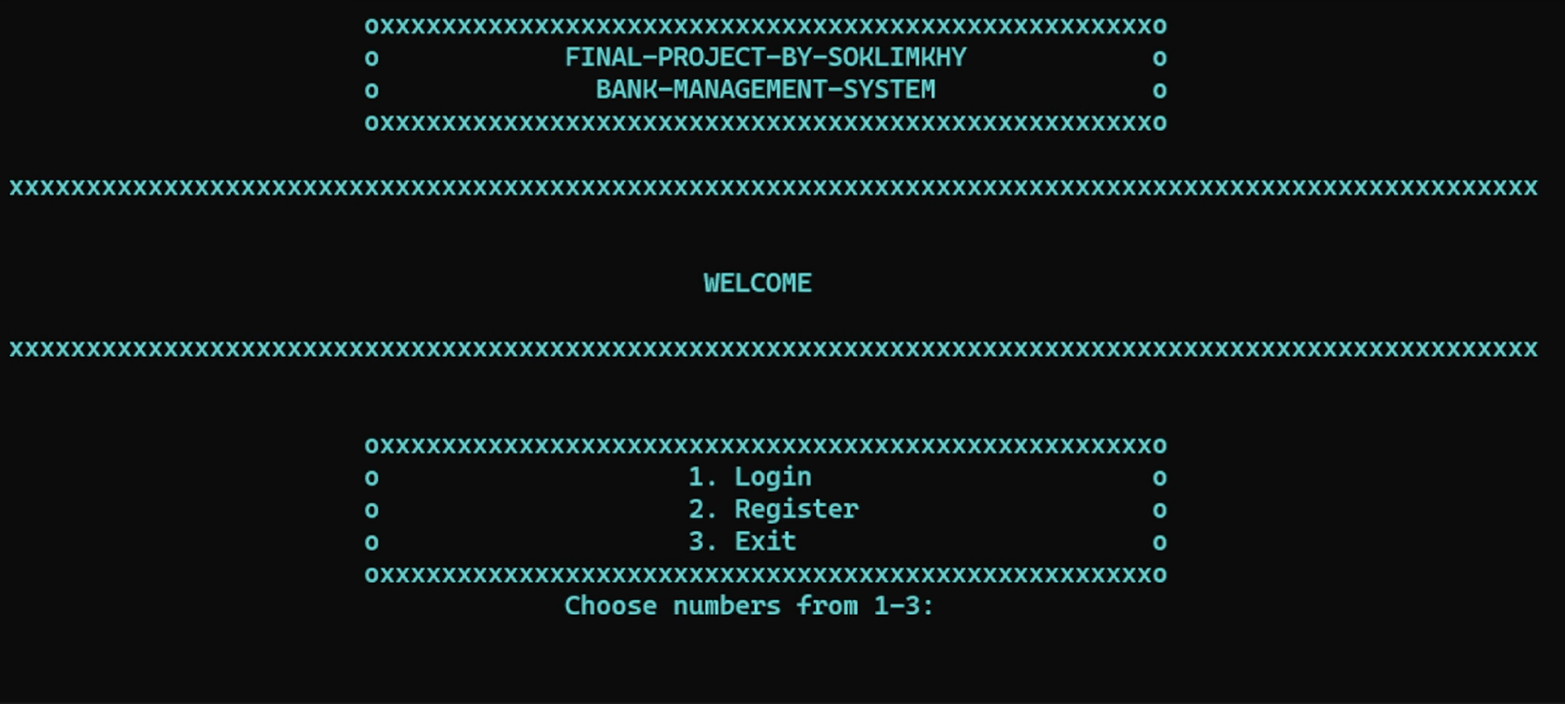
Bank management system
First interface

Slide 7
Bank management system
_ About user features :
1. Wallet
2. Profile
3. View or Search Transactions history
4. Sort transactions by ID
5. Delete transactions by ID
6. Log out

Slide 8
Future Plans
Developing on each platform
Adding smart AI-chatbot and AI-detector
Adding Blockchain easier to use with faster way to pay
Building the strongest security bank

